Slide 1
Local History Project
Deptford in
Victorian Times
Key Stage 2
What was life like for
Victorian children attending the
Deptford Ragged School?

Slide 2
Local History Project
Deptford in
Victorian Times
Key Stage 2
https://www.deptfordraggedschoolarchive.org.uk
Please see the website for lesson plans and project downloads, worksheets and historical sources.

Slide 3
Lesson 1 – Historical information & vocabulary
Deptford in 1844
Deptford: in 1844, very dirty streets. Too dangerous for police to patrol alone.
There were 30,000 homeless children in London. Many lived on streets or under railway arches.
High unemployment
Poverty
Poor living conditions, very little sanitation, very little privacy
10 people could be living in one room
Circa 1889: 1,300 people lived in 50 very small houses. (average 26 people per house)
Sickness & fever could spread very quickly
Some children had homes. Some homes for the poor without doors or furniture as they were used for fuel.
Name of Deptford made people think of unimaginable squalor (grime & dirtiness). I was never taken there and somehow was brought up to think of it as dark, dirty, common and low.
Very close, Friendly Street, to Lewisham and Brockley, were there were rich houses. Families with servants, maids and horse and carriages.
Children from the rich houses were forbidden to go to Deptford, their nannies were forbidden to take them.

Slide 4
Lesson 1 – Historical information & vocabulary
Ragged from documents in the Deptford Ragged School Archive we know that
The children were so called because they were dressed in rags with ‘bare feet in all weathers.
Children described as half-starved, half-dressed and half-wild’. From a DRSA report. DATE?
Some children were so neglected and uncared for that they didn’t have names, known by nicknames.
In 1862 the teachers defend appearance of the children who go to the Deptford Ragged School. ‘Our schools are essentially ragged schools, none are too ragged for admittance, everyone is welcome’.
In 1900 a teacher describes a boy as very pale and thin, in a coat very tightly done up as he had no clothes on under the coat
In some families there was only one pair of boots. Son wore them in the morning, daughter in afternoon, mother wore them out in the evening.

Slide 5
Lesson 1 – Historical information & vocabulary
School: Deptford Ragged School #1
In 1844 Deptford Ragged School started by William Agutter and seven other men and women in a small, rented room. They crammed as many children in as possible.
Appalled by the poverty and living conditions that he saw, was particularly concerned about the children.
Children were between ages 5-13.
Children were taught to read and write. They were taught bible stories on a Sunday.
Teachers visit children at homes and see scenes of poverty and hardship/suffering, reporting that there is no fire or food in many homes.
Many children did not have enough food to eat and suffered from starvation.
In 1869 teachers report that need to feed the children before they teach them. They feed the children bread and soup.
The children are often described as badly behaved and rebellious.
Classes were sometimes disrupted by troublemakers. On occasions mud and stones were thrown at the teachers, and mice and birds brought into school and let loose
A retired policeman was hired as a doorkeeper to help keep things in control.
The Deptford Ragged School often provided clothes and blankets for the children and their families.

Slide 6
Lesson 1 – Historical information & vocabulary
School: Deptford Ragged School #2
The Deptford Ragged School ran a sewing club for girls to make and repair clothes
The Deptford Ragged School ran a Boot Club for families to save up for clothes and boots
Grocery, coal and hospital tickets given out to those in most need. Hospital tickets taken to Miller Hospital in Greenwich for medical care.
Hospital treatment needed to be paid for. The Deptford Ragged School also paid for a doctor to give medical help to those who could not afford it.
The Deptford Ragged School acted as an employment agency for girls leaving school and looking for work. Mostly going into service as a maid or servant.
1846 there were too many children for the room, so the Deptford Ragged School moved to a new room above a stable in Giffin Street. Now 80 children came to the school.
1851: began to teach adults as well, in the evenings, as many adults could not read and write.
In 1859 400 children were taken to a filed in Brockley as a school trip/treat. To get some ‘fresh air in the country’.
In 1870 the government introduced compulsory education for children aged 5-10 but did not enforce it. Generally, children had to pay to go to school.
Some children couldn’t go to school because their families needed them to work and earn money.

Slide 7
Lesson 1 – Historical information & vocabulary
School: Deptford Ragged School #3
The Deptford Ragged School continued to provide an education for children and adults, teaching children who couldn’t afford school and those that had left government funded schools without being able to read and write.
In 1886 the Deptford Ragged School raised money to build a purpose-built school in Giffin Street. 170 children attending each day.
In 1914 a second building built in Hales Street, called the Princess Louise Institute after its patron, Princess Louise.
Each year the Deptford Ragged School produced a report describing what had happened at the school during the year. There are many reports in the Deptford Ragged School Archive. This project uses these reports as historical sources to learn about the life of Victorian children in Deptford. Excerpts are available to download here.

Slide 8
Lesson 1 – Historical information & vocabulary
Archive
Similar to a museum, an archive is a collection of historical documents providing information about a place, institution, or group of people. The Deptford Ragged School Archive has a collection of objects that tells a story about the Deptford Ragged School. The Deptford Ragged School Archive is different to a museum as it does not have a building with an exhibition that people can visit.
Documents= reports, photographs, maps, letters, diaries, school registers, leaflets and fliers. These documents can tell the story of what life was like for children who went to the Deptford Ragged School.
However, documents cannot tell us everything, they are one way of gathering evidence. There are some things we can never know as we don’t have the evidence. There will be missing parts of the story and that’s OK.

Slide 9
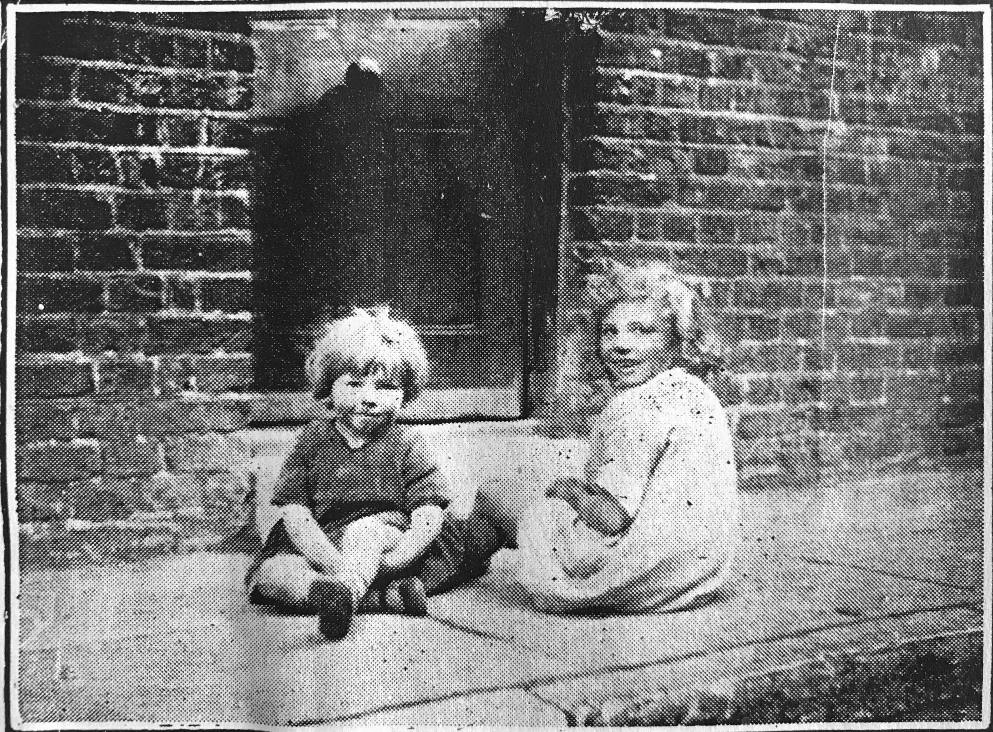
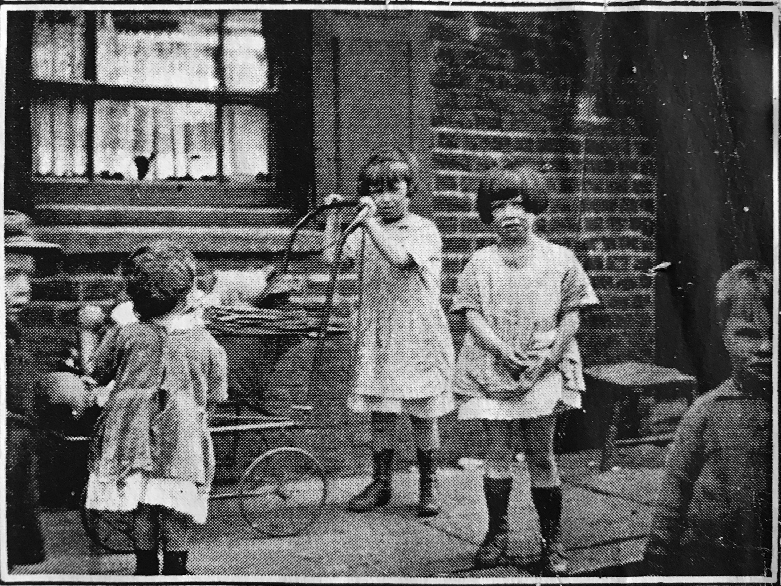
Lesson 2: Analyse historical sources to gather evidence of life in Victorian times

Slide 10
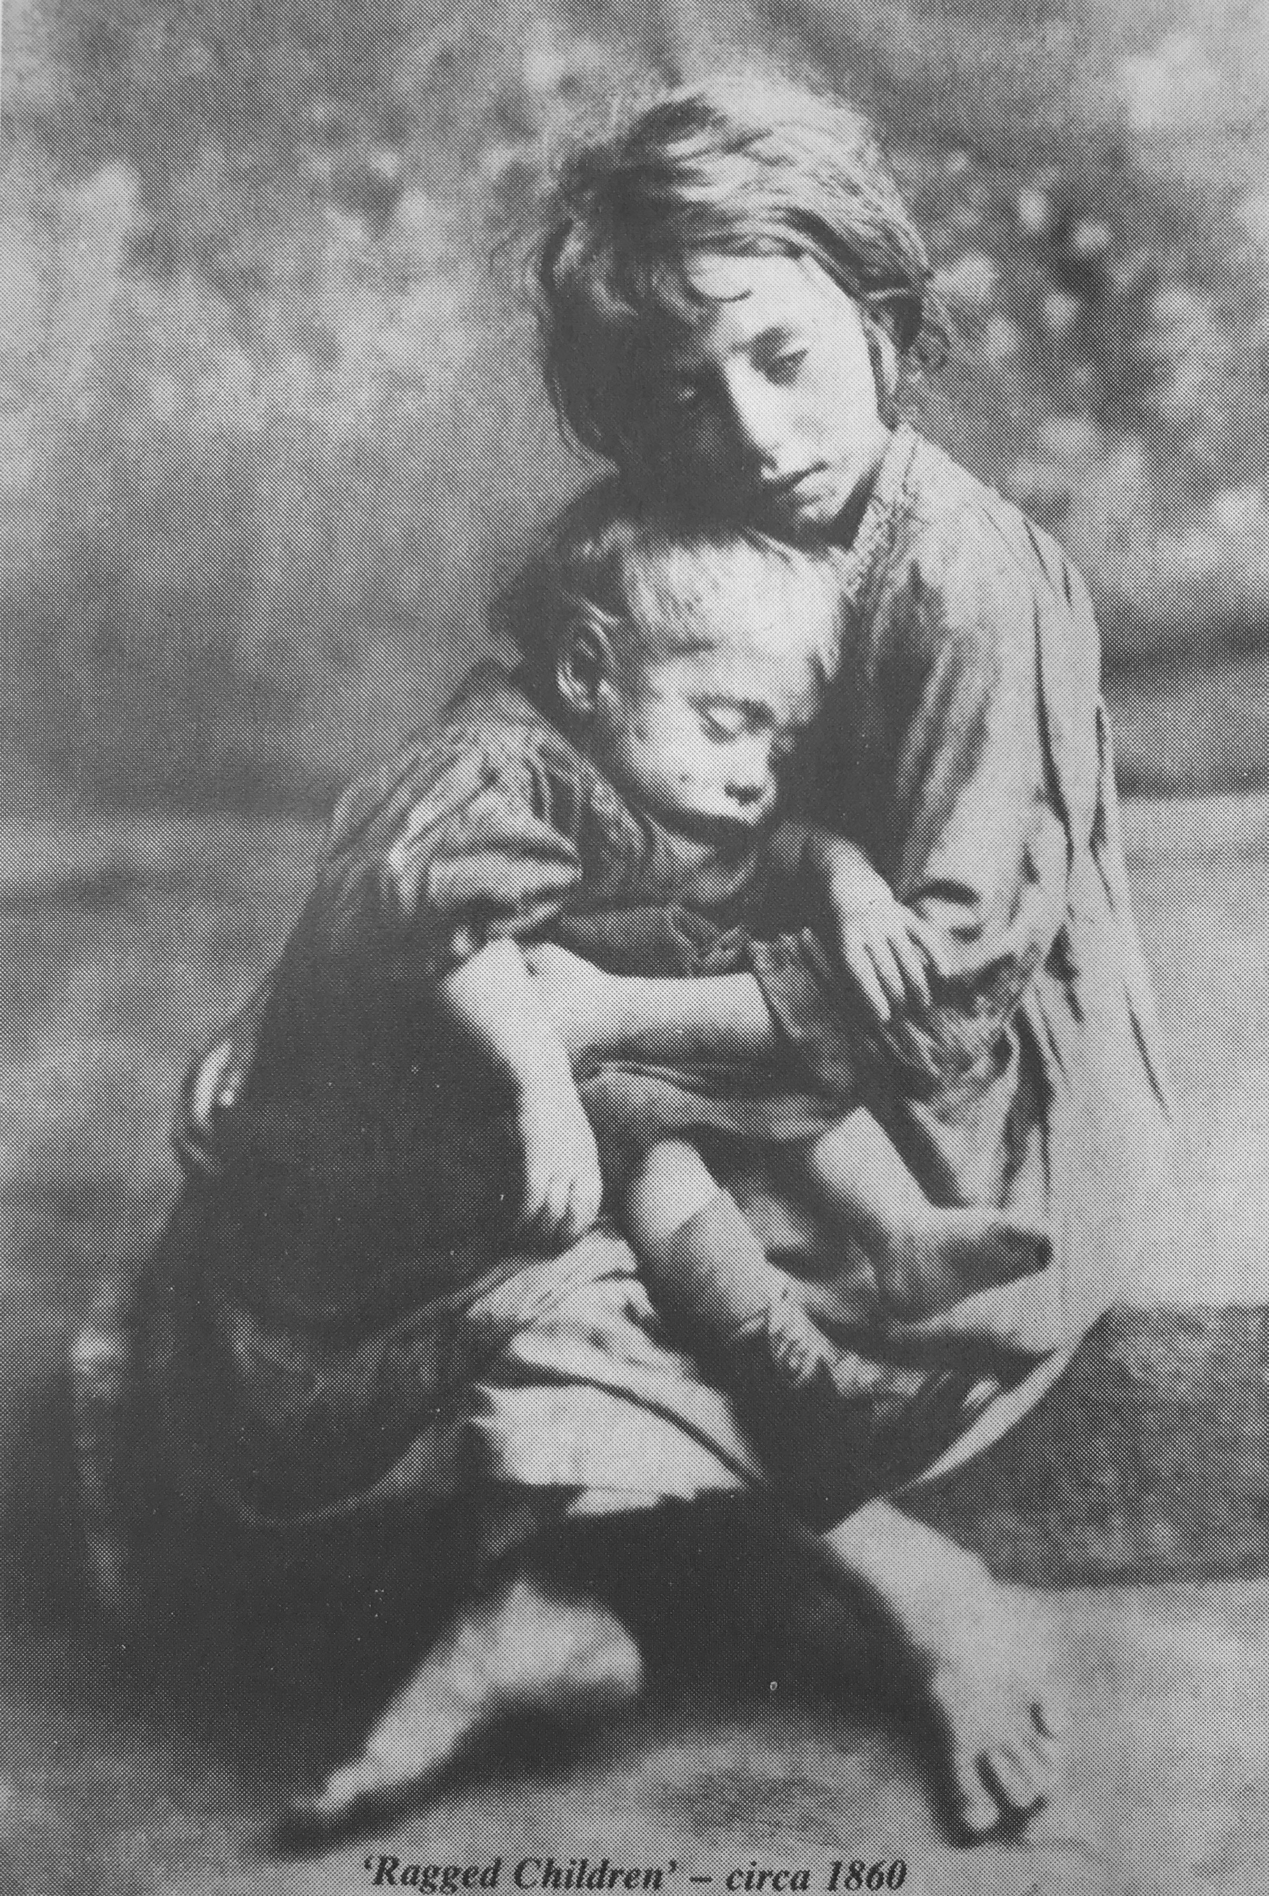
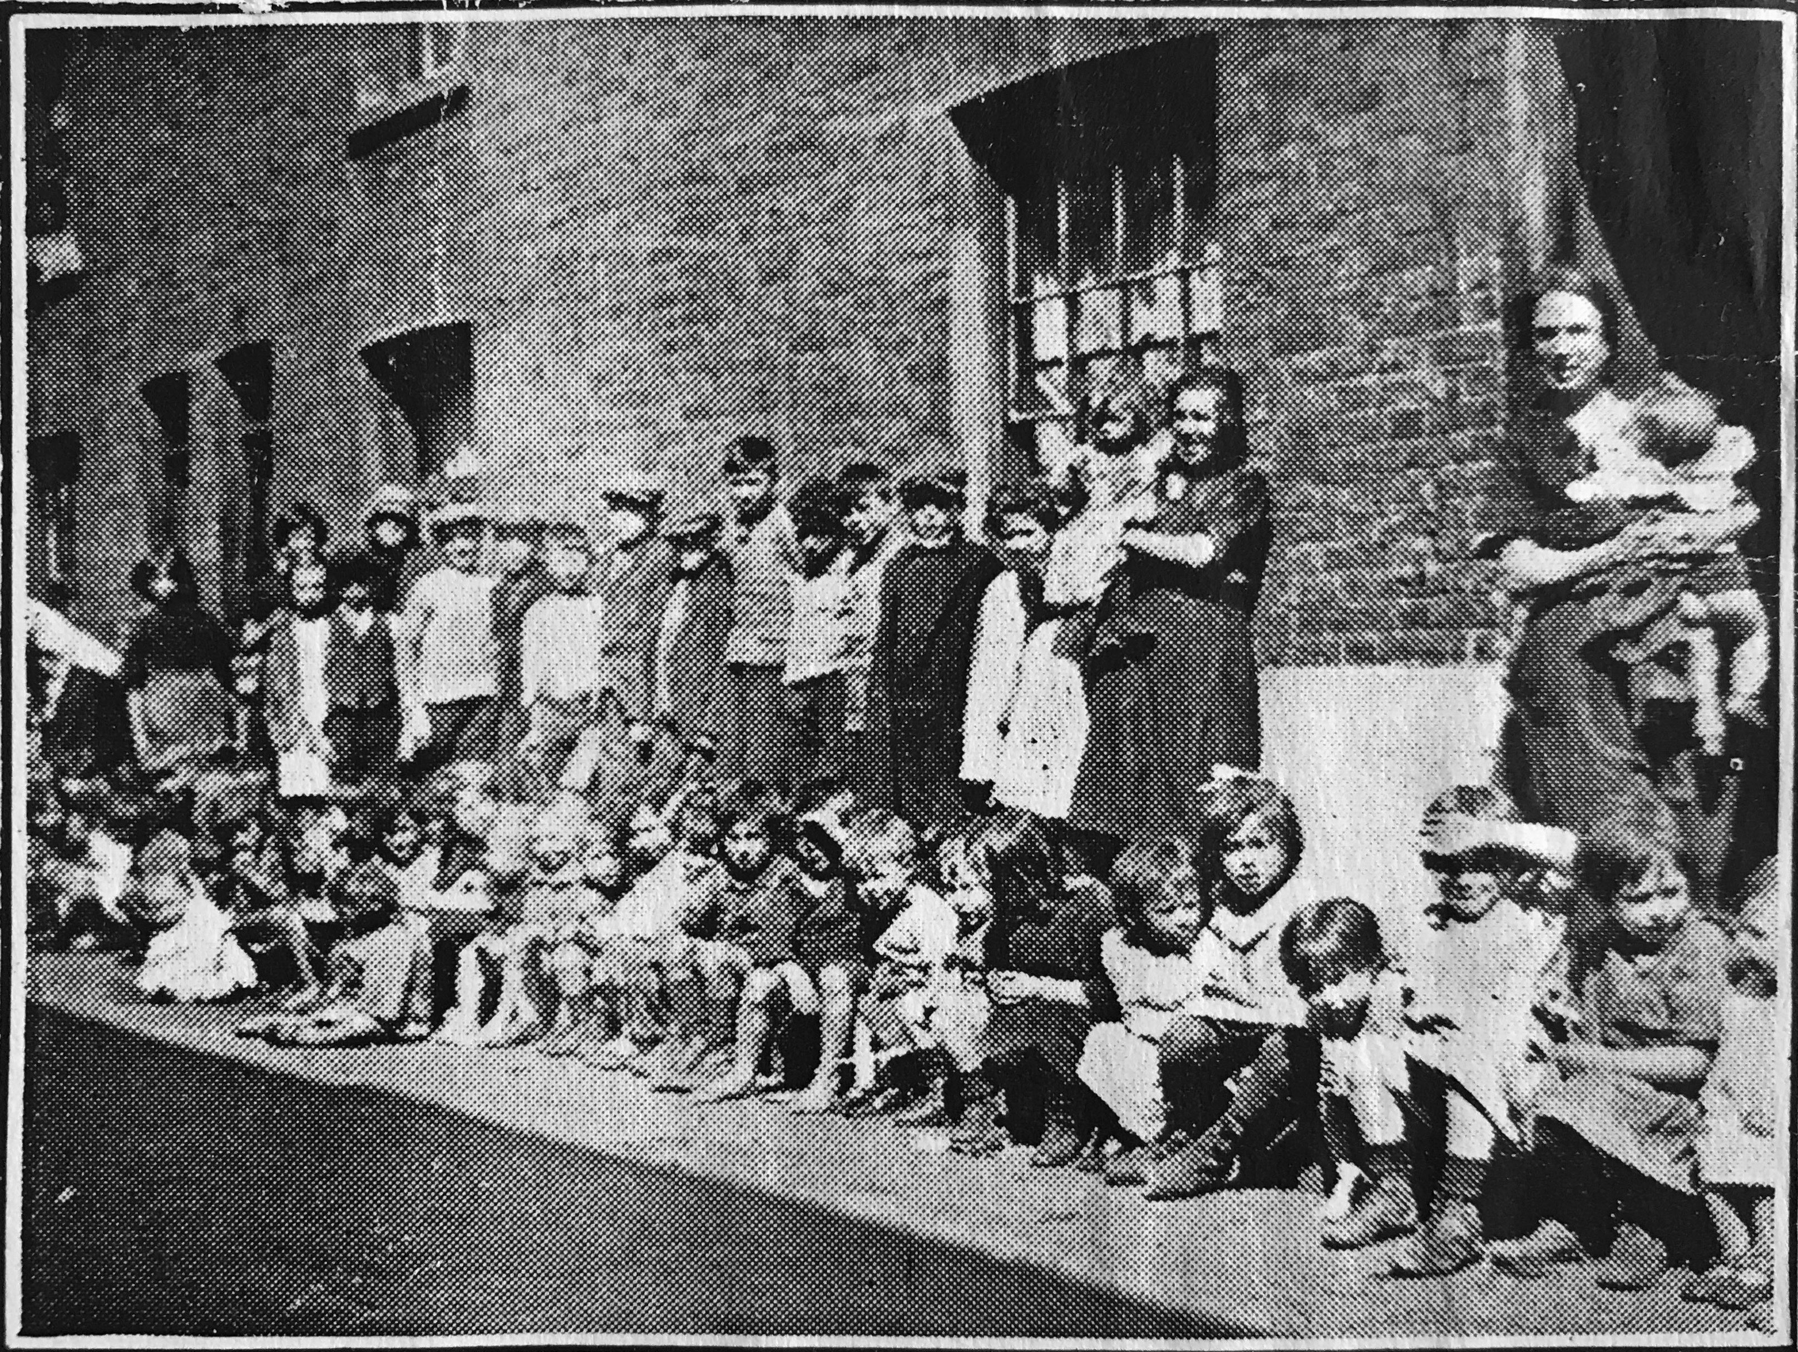
Lesson 2: Analyse historical sources to gather evidence of life in Victorian times

Slide 11
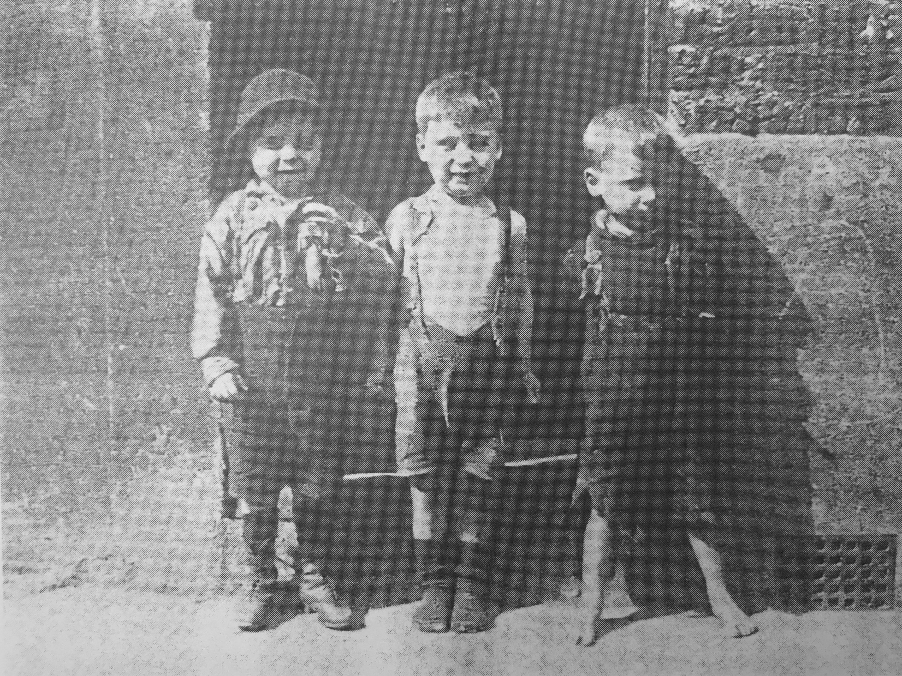
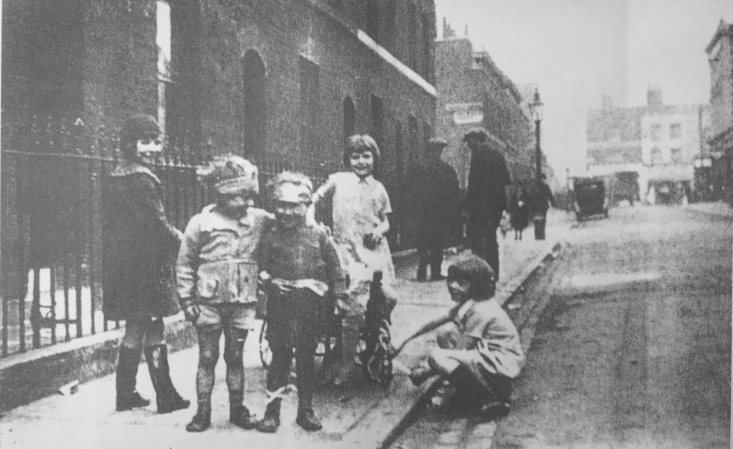
Lesson 2: Analyse historical sources to gather evidence of life in Victorian times

Slide 12
Lesson 3: Research the Deptford Ragged School using archive material
Questions
What is the Deptford Ragged School?
What were the children like who went to the Deptford Ragged School?
What activities and lessons were run by the Deptford Ragged School?
What interesting facts have you found out about the Deptford ragged School?
Further questions
Who started the Deptford Ragged School and why?
What did children learn?
What were the children like?
What did the teachers think of the children
What were the teachers like?
Use evidence from the sources to back up your answer
What other questions can you ask?

Slide 13
Lesson 4: Use source material to develop a fictional character based on evidence
What is your character’s name?
Describe their appearance
Describe their personality
Describe their family and friends
What is their life like?
What might be going on in their life?
Use the archive documents to research
Why do they go to the Deptford Ragged School?
What activities do they go to at the school?
How has the Deptford Ragged School helped them and their family?
What is the best thing for them about the Deptford Ragged School?
Further questions:
What is your character saying?
What are they thinking?

Slide 14
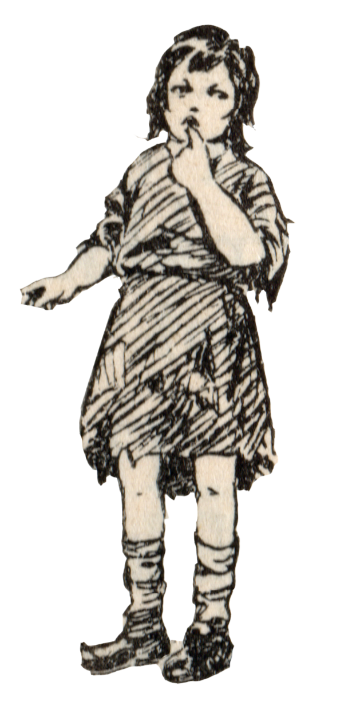
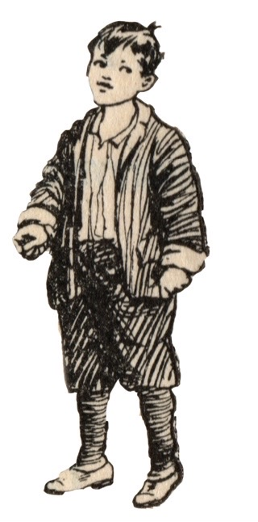
Lesson 4: Use source material to develop a fictional character based on evidence

Slide 15
Lesson 5: Write a letter to a Deptford ragged child explaining the future
Topic ideas
Deptford
London
School
Food
Clothes
Transport
Technology
Games & hobbies

